Slide 1


Slide 2
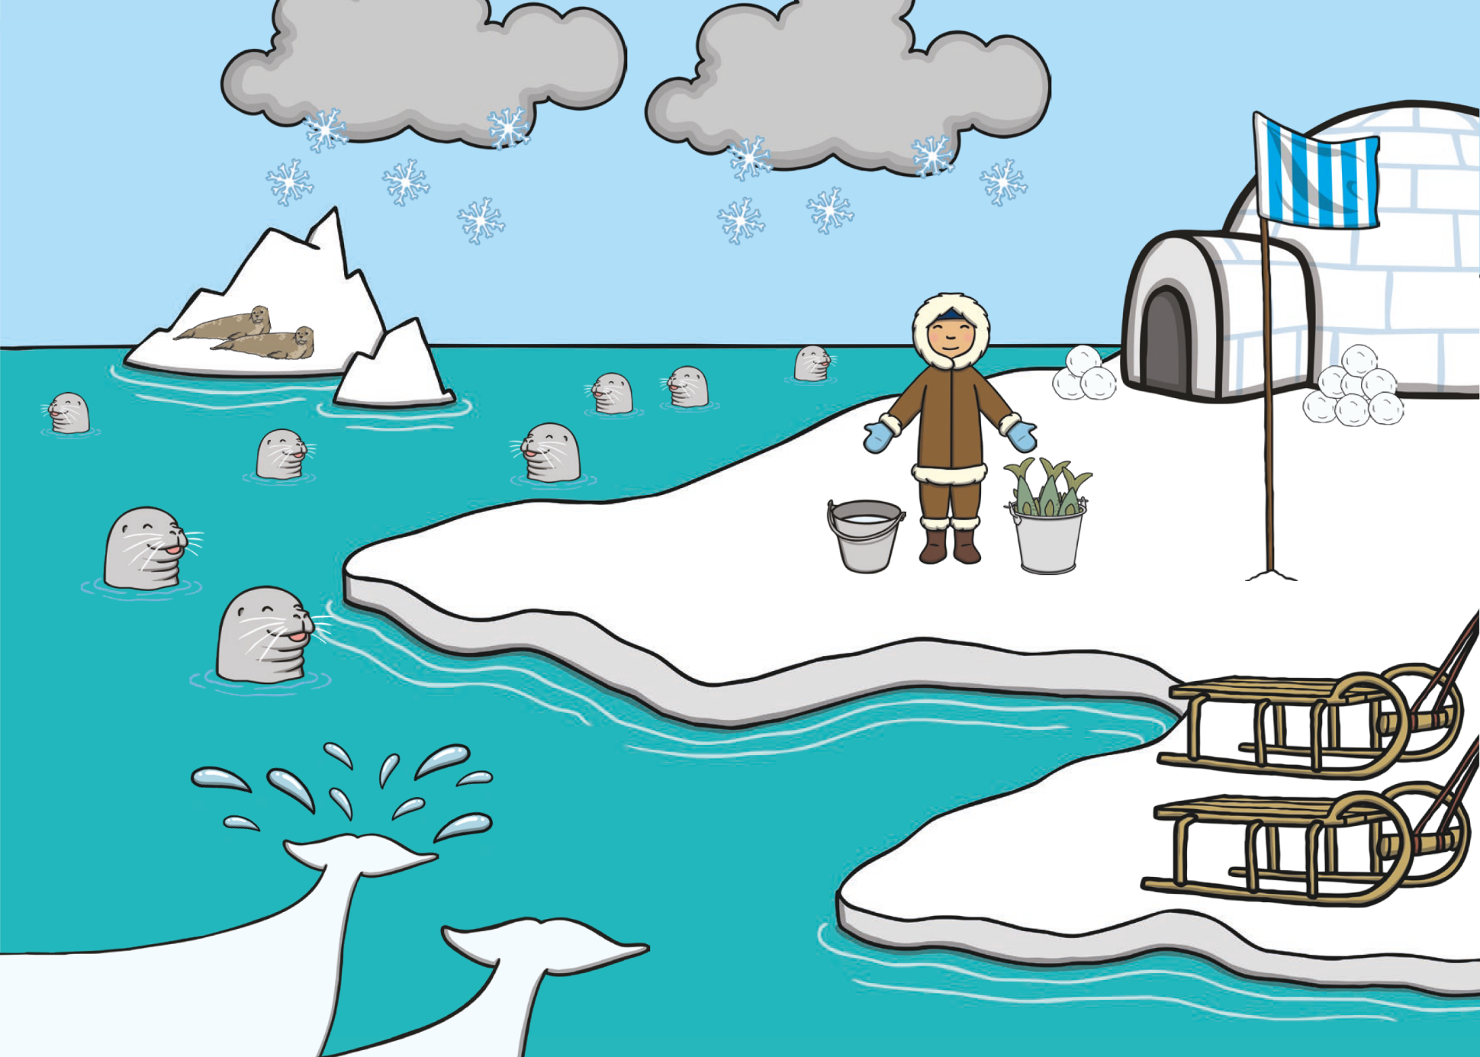
Right-click to ‘Change Picture’.
To hyperlink certain parts of the scene, create a shape box with no fill, then hyperlink to desired slide.

Slide 3
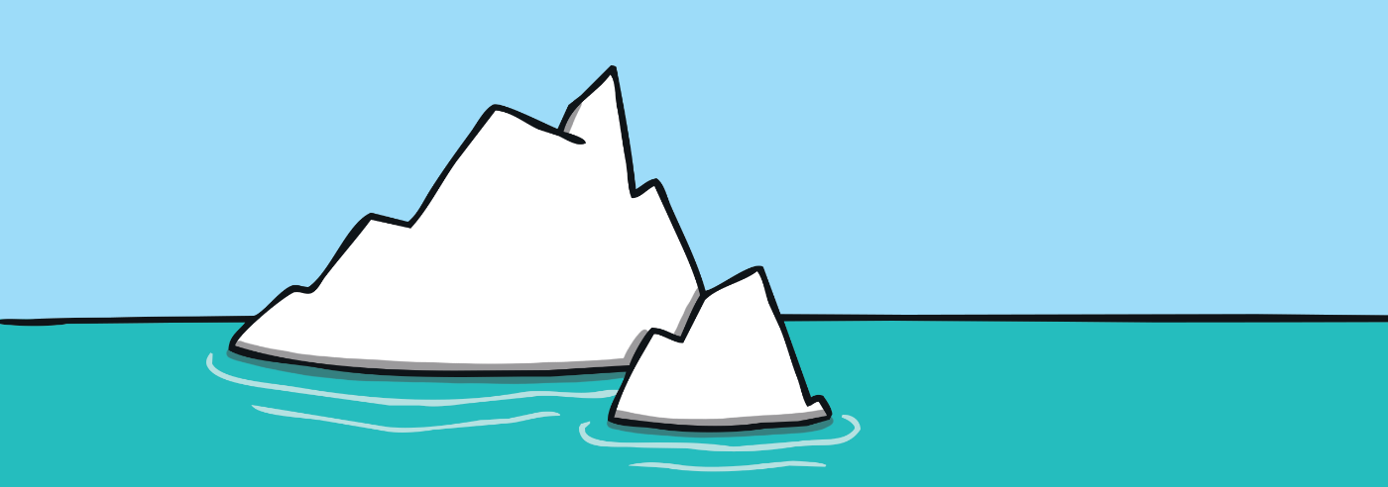
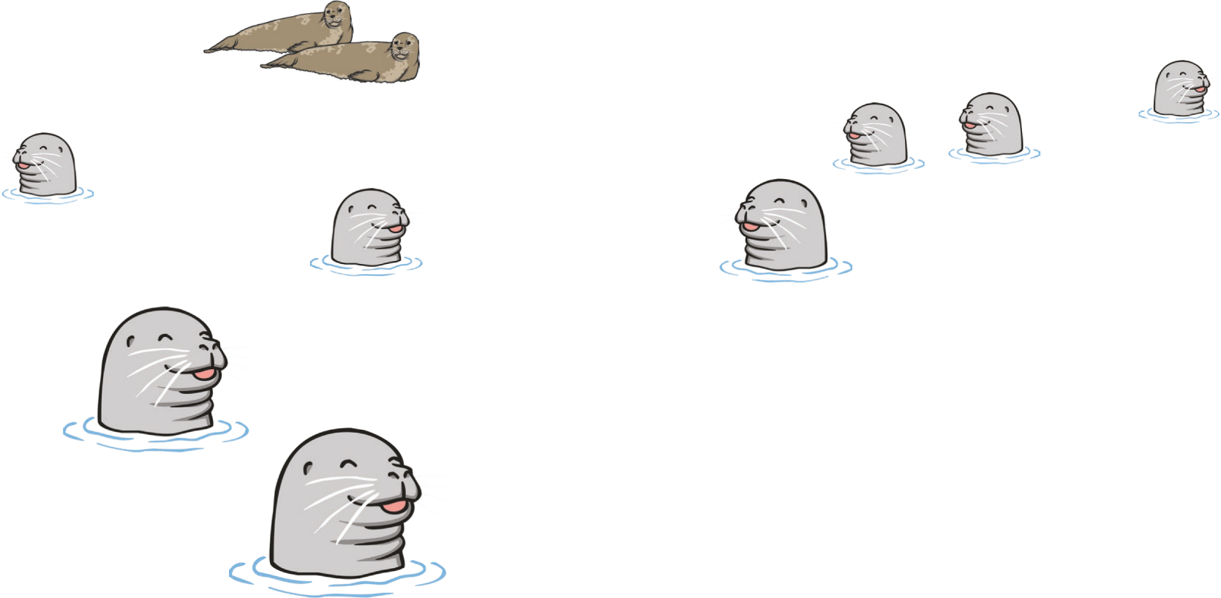
back to the picture
next

Slide 4

back to the picture
next

Slide 5

back to the picture
next

Slide 6

back to the picture
next

Slide 7
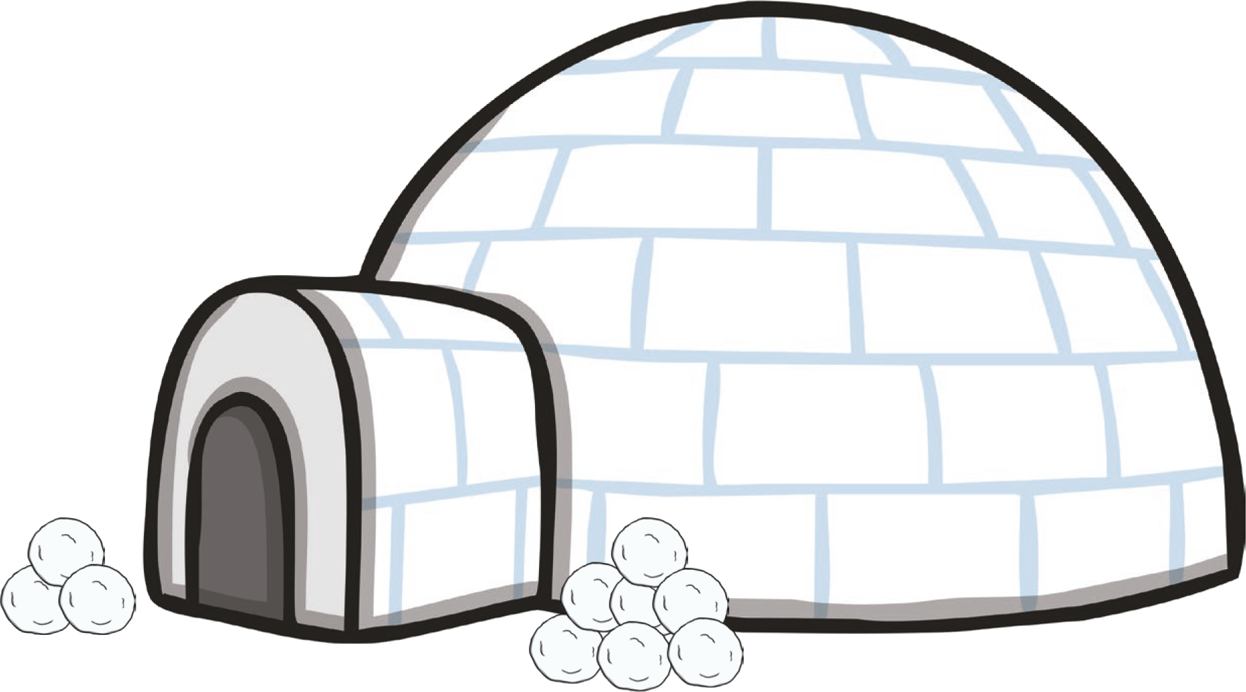
back to the picture
next

Slide 8

back to the picture
end

Slide 9


